Slide 1



Happy Halloween
Take your name tag
Take some candies
Check-in

Slide 2


Happy Wednesday
Name tag
Check-in

Slide 3
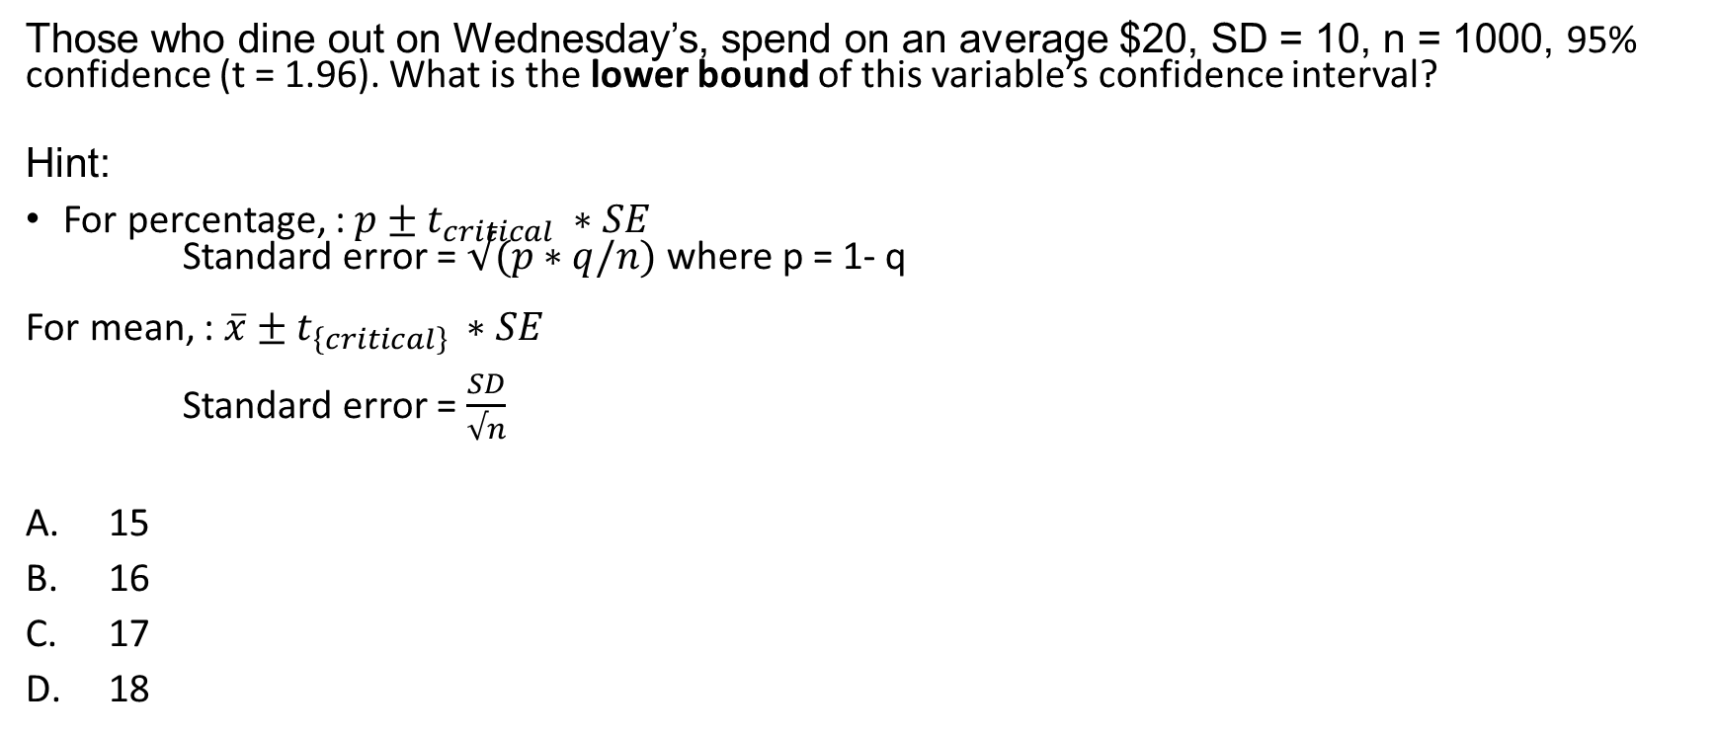
iClicker Question
Those who dine out on Wednesday’s, spend on an average $20, SD = 10, n = 1000, 95% confidence (t = 1.96). What is the lower bound of this variable’s confidence interval?
Hint:
For percentage, : $p±t_{critical} ∗SE$
Standard error = $√(p∗q/n)$ where p = 1- q
For mean, : $\overline{x}±t_{\left\{critical\right\}} ∗SE$
Standard error = $\frac{SD}{√n}$
15
16
17
18
Notes:
D

Slide 4
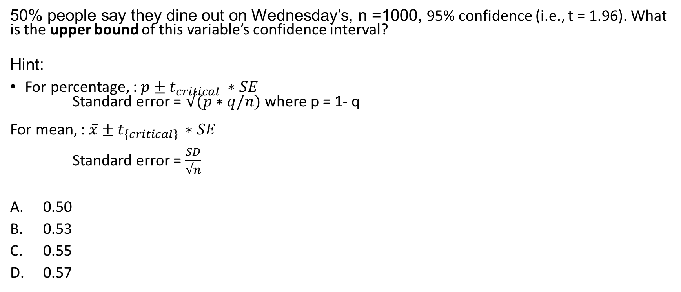
iClicker Question
50% people say they dine out on Wednesday’s, n =1000, 95% confidence (i.e., t = 1.96). What is the upper bound of this variable’s confidence interval?
Hint:
For percentage, : $p±t_{critical} ∗SE$
Standard error = $√(p∗q/n)$ where p = 1- q
For mean, : $\overline{x}±t_{\left\{critical\right\}} ∗SE$
Standard error = $\frac{SD}{√n}$
0.50
0.53
0.55
0.57
Notes:
0.52

Slide 5
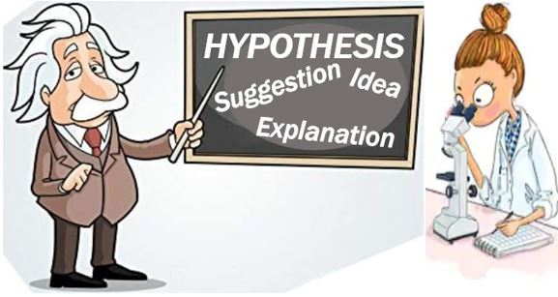
Hypothesis Statement
A hypothesis is an educated guess about something in the world around you. It should be testable, either by experiment or observation. For example:
A new medicine you think might work.
A way of teaching you think might be better.
“If I…(do this to an independent variable)….then (this will happen to the dependent variable).”
Notes:
SO the first thing today, we will cover hypothesis
Can somebody define what a hypothesis is?
Can you give an example of a hypothesis?
The main purpose of statistics is to test a hypothesis.
More examples: A possible location of new species.
A fairer way to administer standardized tests.
When we propose a hypothesis, it’s customary to write a statement. Your statement will look like this:
“If I…(do this to an independent variable)….then (this will happen to the dependent variable).”

Slide 6
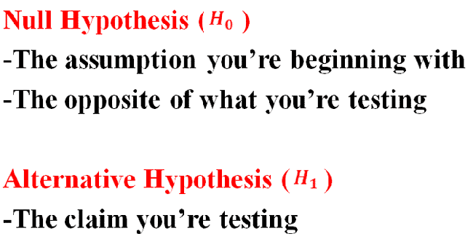
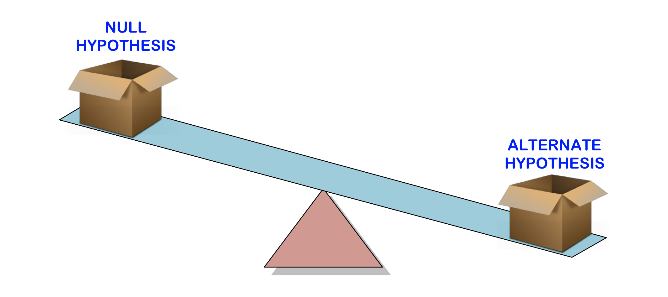
Hypothesis Testing
Hypothesis testing is a way for you to test whether your results are valid by calculating the odds (probability) that your results have happened by chance.
Steps for evidence-based science:
State your null hypothesis and alternative hypothesis,
Choose what kind of test you need to perform,
Either support or reject the null hypothesis.
Notes:
After having your hypothesis, you have to decide what type of hypothesis test is appropriate to figure out if you statement is likely to be true
Formally, hypothesis testing is …
And the three steps for evidence-based science are …
A quick tip to think about null and alternative hypothesis is that alternative hypothesis is the claim you are trying to test
While null hypothesis is the opposite of what you are testing, or conventional wisdom.

Slide 7
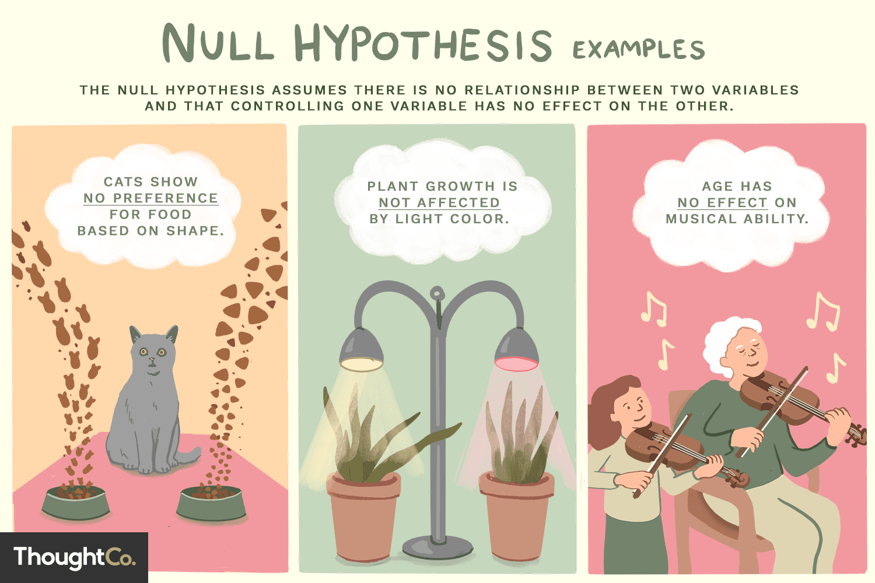
Null Hypothesis
The null hypothesis is usually the accepted fact. Simple examples of null hypotheses that are generally accepted as being true are:
H0: There is no difference between males and females in the satisfaction level regarding the rec center
H1/ HA: There are differences between males and females in the satisfaction level regarding the rec center
Notes:
Another way to think of null hypothesis is that it is usually the accepted fact.
An example of the null hypothesis that there is …
More examples include
As you can see that most null hypotheses contain the status quo.
Now we can go to the Rscript to visualize hypothesis testing
Go to the Rscript

Slide 8
Hypothesis Testing
THE ISSUE: How can we tell if a particular result in the sample represents the true situation in the population… or simply occurred by chance?
HYPOTHESIS: Unproven propositions about some phenomenon of interest.
NULL HYPOTHESIS: The hypothesis that a proposed result is not true for the population.
ALTERNATIVE HYPOTHESIS: The hypothesis that a proposed result is true for the population.

Slide 9
Hypothesis Testing
SIGNIFICANCE LEVEL (α)
The acceptable level of error selected by the researcher, usually set at 0.05. The level of error refers to the probability of rejecting the null hypothesis when it is actually true for the population.
p-VALUE
The probability of obtaining a given result if in fact the null hypothesis were true in the population. A result is regarded as statistically significant if the p-value is less than the chosen significance level of the test.

Slide 10


Common Misinterpretations of what “Statistically Significant” Means
Viewing p-values as if they represent the probability that the results occurred because of sampling error (e.g., p = .05 implies that there is only a .05 probability that the results were caused by chance)
Assuming that statistical significance is the same thing as managerial significance
Viewing the $α$ or p levels as if they are somehow related to the probability that the research hypothesis is true (e.g., a p-value such as p>.001 is “highly significant” and therefore more valid than p< .05).

Slide 11
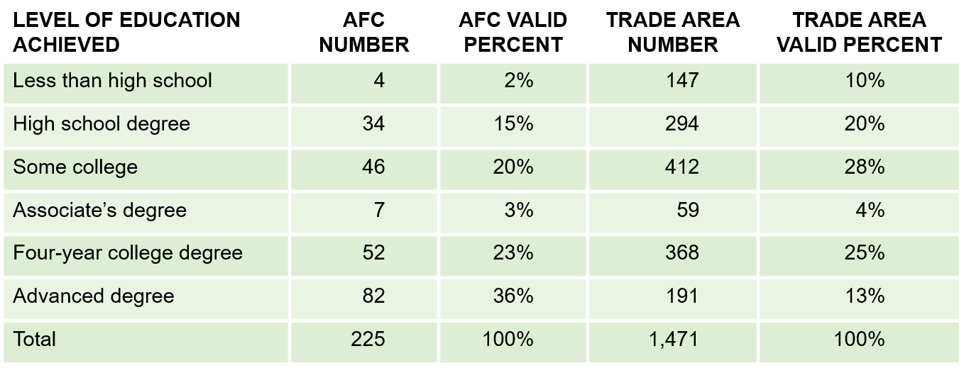
Testing Hypotheses about Individual Variables
Categorical Variables: Chi-square goodness-of-fit test: A statistical test to determine whether some observed pattern of frequencies corresponds to an expected pattern.
Exhibit 17.8 AFC Customer Education Level Versus Education Level in Trade Area
(Χ² = 118.38, 5 d.f., p < .001)

Slide 12
Testing Hypotheses about Individual Variables
Continuous Variables: A one-sample t-test can be used to compare a sample mean against an external standard. The analysis is easy to implement in a standard statistical software analysis package.

Slide 13
Independent t-test
Hypothesis tests use samples to infer properties of entire population
T-test compare means
2 sample t-tests compare the means of 2 groups
Are two population means different?
Null and Alternative Hypotheses
Null: The two-group means are equal
Alternative: The two-group means are NOT equal
Statistically results: Reject the null hypothesis when the p-value < significance level
The formula for the independent t-test depends on the two samples’ variances
Equal variance
Unequal variance
For formal formulas: visit here
Notes:
The one sample t-test is rarely used with mean value, because we usually don’t have a good estimate or prior knowledge.
This t-test is equivalent to the coefficient t-test that we will cover later in regression. But we know we turn our attention to 2 independent samples t-test
Since all group have a difference research question between 1 categorial variable and 1 continuous variable, I’ll cover independent sample t-test
But we will not cover two-way chi-square test, which is for 2 categorical variables.
Other sessions do not cover either but I think this test is critical for you to understand and be able to present difference research questions.
Other sessions just do descriptive statistics that I do not think yield as much value as formal statistical tests.
And just a quick note for you that there is another type of t-test besides independent t-test and one sample t-test, which is paired t-test
Which is used in cases like you have before and after treatment, or twin study.
Start reading the slide

Slide 14
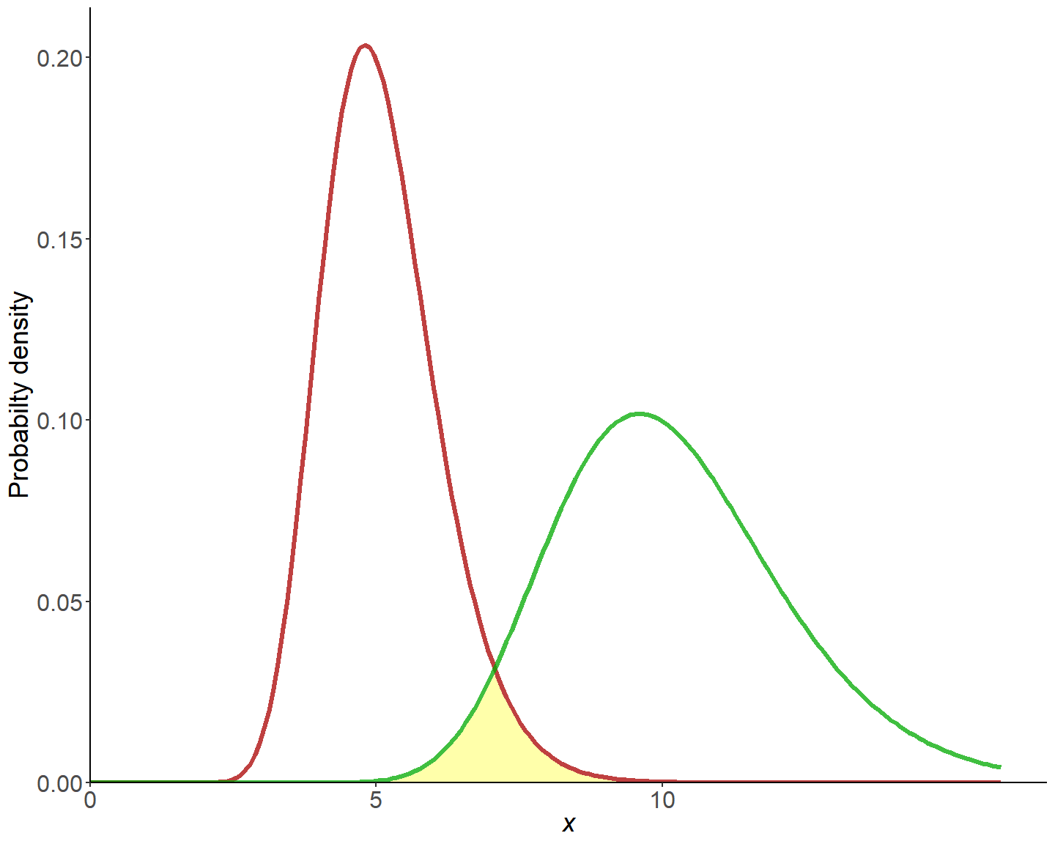

F-test for 2 Variances
H0: $σ_{x}^{2}=σ_{Y}^{2}$
H1: $σ_{x}^{2}≠σ_{Y}^{2}$
The shape of the 2 distributions can affect the mean hypothesis testing.
Notes:
Before we get to the t-test, we have to know whether the two samples’ variances are equal. Hence, we can use the F-test for 2 variances to figure this out.
I do not expect you to memorize the formula, but at least know how to use the software to derive at your result.
I can give you an intuitive understanding here.

Slide 15
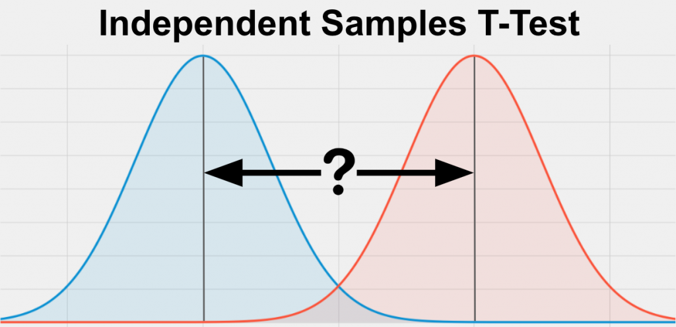

Two-sample independent t-test
H0: $μ_{x}=μ_{y}$
H1: $μ_{x}≠μ_{y}$
Based on whether you reject or accept the assumption that the two samples’ variances are equal, then you can select the appropriate test
Notes:
Go to Rscript first, then excel

Slide 16
Data Analysis Plan Template Assignment 6
 |  | Data Analysis Plans
(1) | (2) | (3) | (4) | (5) and (6)
Research Question | Type of Research Question* | Questionnaire Question | Level of Measurement** | Descriptive statistics or Statistical Test
* descriptive or differences research question
** nominal, ordinal, interval, or ratio
Notes:
Go to assignment 6
https://umsystem.instructure.com/courses/41919/assignments/871304?module_item_id=2985137
Show template
Go to the difference quickly
I want to correct my statement in the last class that we did cover cross-tabulation. Hence, you should be able to present the table.
(open the data analysis plan example and regression descriptive statistics doc).

Slide 17
15-min Group Discussion
Sign up for presentation day (same link for the project meeting)
Each team will present 15 mins and 5 mins Q&A
Not all group members need to present (As long as your group finds optimal task allocation). Does not mean you can just skip class.
Discuss questions that allow you to use descriptive statistics (e.g., mean, prop, confidence interval, cross-tabulation) and independent t-test
Notes:
Do not skip class.

